Slide 1
DATABASE MANAGEMENT SYSTEMS
Serializability
The Correctness Standard for Concurrent Schedules
Unit — Transaction Management & Concurrency Control | CSE (AI & ML)

Slide 2
DEFINITION
What Is Serializability?
A schedule of concurrent transactions is serializable if its effect on the database is equivalent to some serial (one-at-a-time) execution of the same transactions.
1
2
3
Serial Schedule
Concurrent Schedule
The Goal
Transactions run one after another, with zero interleaving. Always correct, but slow.
Transactions interleave for performance. May or may not be correct.
Allow interleaving — but only schedules equivalent to some serial order.
Serializability
2

Slide 3
BUILDING BLOCK
Conflicting Operations
Two operations from different transactions conflict when all three hold:
1
They belong to different transactions
2
They access the same data item
3
At least one of them is a write
Read – Read
Read – Write
Write – Write
Never conflicts
Conflicts
Conflicts
Serializability
3

Slide 4
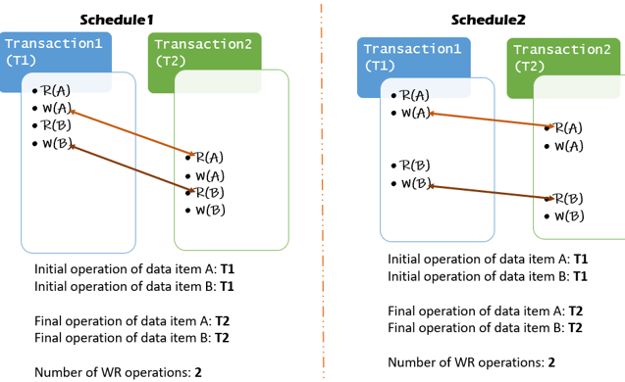

Slide 5
TWO NOTIONS
Conflict Serializability vs. View Serializability
Conflict Serializability
View Serializability
A schedule is conflict-serializable if it can be transformed into a serial schedule by swapping consecutive non-conflicting operations.
A schedule is view-serializable if it is equivalent in “reads-from” relationships and “final writes” to some serial schedule.
Tested using a precedence (serialization) graph — easy to check.
More general — every conflict-serializable schedule is view-serializable, but not vice versa. Hard to test (NP-complete).
Serializability
4

Slide 6
TESTING CONFLICT SERIALIZABILITY
The Precedence Graph
Build a graph with one node per transaction. Draw Ti → Tj whenever an operation of Ti conflicts with, and comes before, an operation of Tj.
T2
No cycle
Schedule IS conflict-serializable
T1
Cycle exists
T3
Schedule is NOT conflict-serializable
Acyclic graph shown — T1 → T2, T1 → T3, T2 → T3
Serializability
5

Slide 7
SUMMARY
Serializability — Key Points
1
Serializability is the gold-standard correctness criterion for concurrent schedules.
2
Conflicting operations — same data item, different transactions, one is a write — are what matter for ordering.
3
Conflict serializability is tested with a precedence graph: acyclic means serializable.
4
View serializability is more general but too expensive to test in practice; real systems enforce conflict serializability.

